Slide 1
Linear Regression
(Least Square Error Fit)

Slide 2
Linear Regression
In machine learning and statistics, regression attempts to determine the strength and character of the relationship between one dependent variable (usually denoted by Y) and a series of other variables (known as independent variables).
Mathematically, regression analysis uses an algorithm to learn the mapping function from the input variables to the output variable (Y) i.e. Y = f(x) where Y is a continuous or real valued variable.
Regression is said to be linear regression if the output dependent variable is a linear function of the input variables.

Slide 3
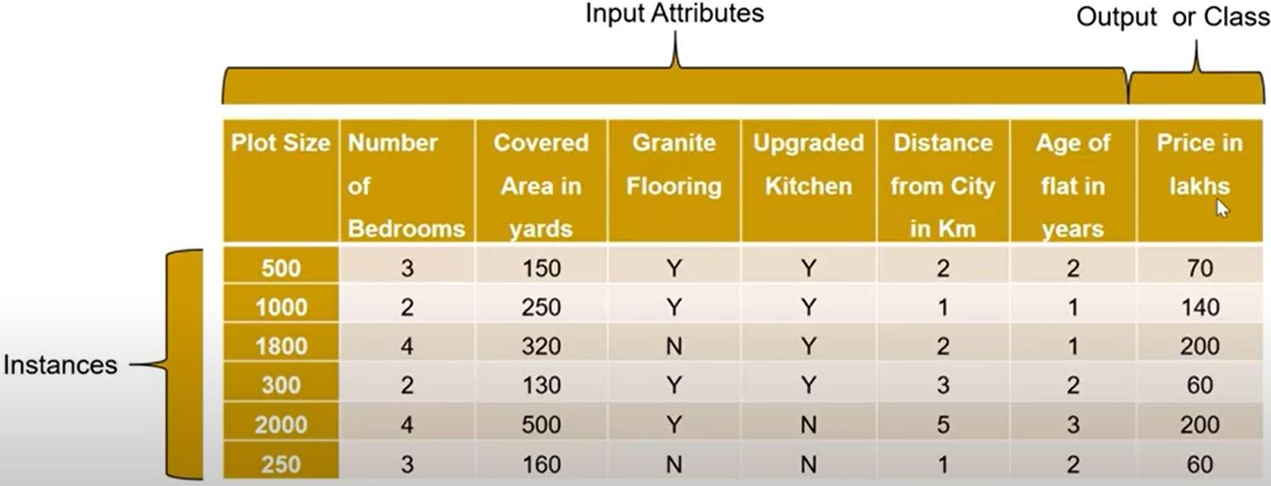
Regression Example
House Value Prediction- The example below shows that the price variable (output dependent continuous variable) depends upon various input (independent) variables such as plot size, number of bedrooms, covered area, granite flooring, distance from city, age, upgraded kitchen, etc.

Slide 4
Simple Linear Regression (SLR)
Simple linear regression is a linear regression model with a single explanatory variable.
It concerns two-dimensional sample points with one independent variable and one dependent variable and finds a linear function (a non-vertical straight line) that, as accurately as possible, predicts the dependent variable values as a function of the independent variable.
The adjective simple refers to the fact that the outcome variable is related to a single predictor.

Slide 5
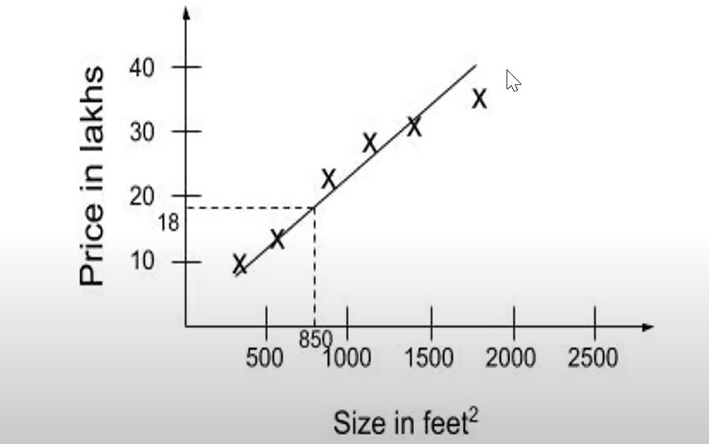
Simple Linear Regression (SLR) Contd….
Simple linear regression finds a linear function (a non-vertical straight line) that, as accurately as possible, predicts the dependent variable values as a function of the independent variable.
For instance, in the house price predicting problem (with only one input variable-plot size), a linear regressor will fit a straight line with x- axis representing plot size and y-axis representing price.

Slide 6
Fitting the Straight Line for SLR
The linear function that binds the input variable x with the corresponding predicted value of (yˆ) can be given by the equation of straight line(slope- intercept form) as:
ˆ=
0 1
where ₁ is the slope of line (i.e. it measures change in output variable y with unit change in independent variable x).
₀ represents y-intercept i.e. the point at which the line touch x-axis
ˆ is the predicted value of the output for the particular value of input variable x.

Slide 7





Cost/Error function for SLR
The major goal of SLR model is to fit the straight line that predicts the output variable value quite close to the actual value.
But, in real world scenario, there is always some error (regression residual) in predicting the values, i.e.
i i
ˆ_{i}
i i
i i
ˆ_{i}
This error may be positive or negative, as it may predict values greater or lesser than actual values. So we consider square of each error value.

Slide 8
Cost/Error function for SLR
The total error for all the n points in the dataset is given by:
𝑇𝑜𝑡𝑎𝑙 𝑆𝑞𝑢𝑎𝑟𝑒 𝐸𝑟𝑟𝑜𝑟 = ∑^{n} 𝜖² = ∑^{n}
i=1 i i=1
n
= Σ(𝑦_{i} − 𝛽₀ − 𝛽₁𝑥_{i})²
i=1
(𝑦_{i} − 𝑦ˆ_{i})²
The mean of square error is called the cost or error function for simple linear function denoted by J(𝛽₀,
𝛽₁) and given by:
n
1
J(𝛽 , 𝛽 )= Σ(𝑦 − 𝛽 − 𝛽 𝑥 )²
0 1 i
0 1 i
𝑛
i=1
There exist many methods to optimize (minimize) this cost/error function to find line of best fit.

Slide 9
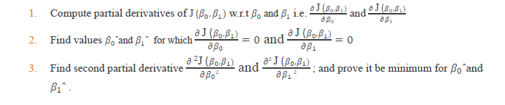
Least Square Method for Line of Best Fit
The least square method aims to find values 𝛽₀ˆand 𝛽₁ˆ for 𝛽₀ and 𝛽₁for which the square error between the actual and the predicted values is minimum i.e. least (So, the name is least square error fit).
The values 𝛽₀ˆand 𝛽₁ˆ for 𝛽₀ and 𝛽₁for which the square error function (J (𝛽₀, 𝛽₁)) is minimum are computed using second derivative test as below:

Slide 10
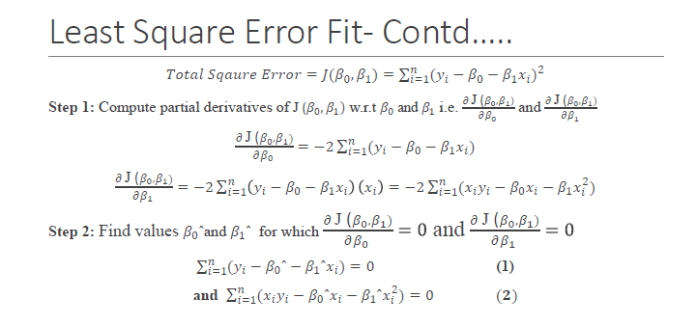

Slide 11
Least Square Error Fit- Contd…..
From equation 1:
∑n
𝑦_{i} − ∑^{n}
𝛽₀ˆ − ∑^{n}
𝛽₁ˆ𝑥_{i} = 0
i=1
i=1
i=1
𝑥_{i} = 0
𝑦_{i}
∑n
𝑦_{i} − 𝑛𝛽₀ˆ − 𝛽₁ˆ ∑^{n}
i=1
i=1
𝑛𝛽₀ˆ + 𝛽₁ˆ ∑^{n}
𝑥_{i} = ∑^{n}
(3)
i=1
i=1
From equation 2:
∑n
𝑥_{i}𝑦_{i} − ∑^{n}
𝛽₀ˆ𝑥_{i} − ∑^{n}
𝛽₁ˆ𝑥² = 0
i=1 i=1
i=1
i
∑n
𝑥_{i}𝑦_{i} − 𝛽₀ˆ ∑^{n} 𝑥_{i} − 𝛽₁ˆ ∑^{n} 𝑥² = 0
i=1 i
i=1
i=1
𝛽₀ˆ ∑^{n}
𝑥_{i} + 𝛽₁ˆ ∑^{n} 𝑥² = ∑^{n} 𝑥_{i}𝑦_{i}
(4)
i=1
i=1 i i=1

Slide 12
Least Square Error Fit- Contd…..
Multiply equation 3 with ∑^{n} 𝑥_{i} and equation 4 by n
i=1
(5)
(6)
𝑛𝛽₀ˆ ∑^{n} 𝑥_{i} + 𝛽₁ˆ( ∑^{n} 𝑥 ) = ∑
n i=1
𝑥_{i} ∑^{n} 𝑦_{i}
i=1 i=1 i
2
i=1
n𝛽₀ˆ ∑^{n}
𝑥_{i} + 𝛽₁ˆn ∑^{n} 𝑥² = 𝑛 ∑^{n} 𝑥_{i}𝑦_{i}
i=1 i=1 i
i=1
Subtracting Equation 5 from 6, we get,
𝜷_{𝟏}ˆ =
𝒏 ∑^{𝒏} 𝒙_{𝒊}𝒚_{𝒊}– ∑^{𝒏} 𝒙_{𝒊} ∑^{𝒏} 𝒚_{𝒊}
𝒊=𝟏
𝒏
𝒊=𝟏 𝒊=𝟏
𝒏
n ∑ 𝒙^{𝟐}–( ∑ 𝒙_{𝒊})^{𝟐}
𝒊=𝟏 𝒊
𝒊=𝟏
From Equation (3),
𝑛𝛽₀ˆ + 𝛽₁ˆ ∑^{n}
𝑥_{i} = ∑^{n} 𝑦_{i}
i=1 i=1
𝛽 ˆ = ¹ ∑^{n}
1
ˆ∑^{n} 𝑥
0
n
i=1 ^{𝑦}i ⁻ _{n} ^{𝛽}1 i=1 i
𝜷_{𝟎}ˆ = 𝒚¯ − 𝜷_{𝟏}ˆ𝒙¯

Slide 13
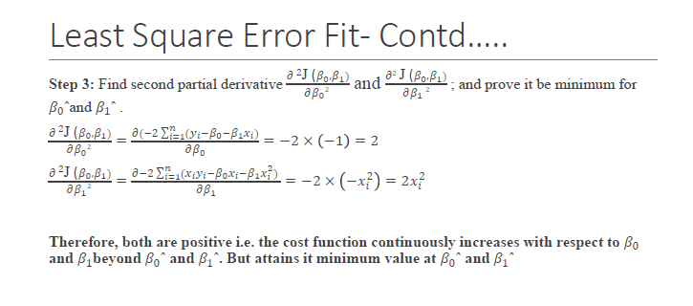

Slide 14
Least Square Error Fit- Summary
The linear function that binds the input variable x with the corresponding predicted value of (yˆ) can be given by the equation of straight line(slope-intercept form) as:
𝑦ˆ=𝛽₀ + 𝛽₁𝑥
The square error in prediction is minimized when
𝑛 ∑^{n} 𝑥_{i}𝑦_{i} − ∑^{n} 𝑥_{i} ∑^{n} 𝑦_{i}
_{𝛽1ˆ =} i=1 i=1 i=1
n ∑^{n} 𝑥² − ( ∑^{n} 𝑥_{i})²
i=_{n}1 i
i=1
𝜎_{y} ∑_{i=1}(𝑥_{i} − 𝑥̅)(𝑦_{i} − 𝑦¯)
=
= 𝑟
xy _{𝜎x}
∑n
(𝑥_{i} − 𝑥̅)²
i=1
and 𝛽₀ˆ = 𝑦¯ − 𝛽₁ˆ𝑥̅

Slide 15

Least Square Error Fit- Example
The data set (shown in table) gives average masses for women as a function of their height in a sample of American women of age 30–39.
Fit a square line for average mass as function of height using least square error method.
Predict the average mass of women whose height is 1.40 m
Height (m), x_{i} |  | Mass (kg), y_{i}
 | 1.47 |  | 52.21
 | 1.50 |  | 53.12
 | 1.52 |  | 54.48
 | 1.55 |  | 55.84
 | 1.57 |  | 57.20
 | 1.60 |  | 58.57
 | 1.63 |  | 59.93
 | 1.65 |  | 61.29
 | 1.68 |  | 63.11
 | 1.70 |  | 64.47
 | 1.73 |  | 66.28
 | 1.75 |  | 68.10
 | 1.78 |  | 69.92
 | 1.80 |  | 72.19
 | 1.83 |  | 74.46

Slide 16
Least Square Error Fit- Example
i | x_{i} | y_{i} | x_{i}2 | x_{i}y_{i}
1 | 1.47 | 52.21 | 2.1609 | 76.7487
2 | 1.50 | 53.12 | 2.25 | 79.68
3 | 1.52 | 54.48 | 2.3104 | 82.8096
4 | 1.55 | 55.84 | 2.4025 | 86.552
5 | 1.57 | 57.20 | 2.4649 | 89.804
6 | 1.60 | 58.57 | 2.56 | 93.712
7 | 1.63 | 59.93 | 2.6569 | 97.6859
8 | 1.65 | 61.29 | 2.7225 | 101.1285
9 | 1.68 | 63.11 | 2.8224 | 106.0248
10 | 1.70 | 64.47 | 2.89 | 109.599
11 | 1.73 | 66.28 | 2.9929 | 114.6644
12 | 1.75 | 68.10 | 3.0625 | 119.175
13 | 1.78 | 69.92 | 3.1684 | 124.4576
14 | 1.80 | 72.19 | 3.24 | 129.942
15 | 1.83 | 74.46 | 3.3489 | 136.2618
Total | 24.76 | 931.17 | 41.0532 | 1548.2453

Slide 17
Least Square Error Fit- Example
𝛽₁ˆ =
n ∑^{n} x_{i}y_{i}– ∑^{n} x_{i} ∑^{n} y_{i}
i=1
n
i=1 i=1 n
n ∑ x –( ∑ x )
2
i
2
i=1 i
i=1
𝛽 ˆ =
15×1548.2453 –24.76 ×931.17
= 61.19
1
15×41.0532–24.76²
𝛽₀ˆ = 𝑦¯ − 𝛽₁ˆ𝑥̅
24.76
𝛽₀ˆ =
931.17
— 61.19 × = −38.88
15 15
Therefore the line of best fit is given by: 𝑦ˆ= − 38.88 + 61.19𝑥
Predicted value of y when x is 1.4 is
𝑦ˆ= − 38.88 + 61.19 × 1.4 = 46.78

Slide 18
Multiple Linear Regression (MLR)
Multiple regression models describe how a single response variable Y depends linearly on a number of predictor variables.
Examples:
The selling price of a house can depend on the desirability of the location, the number of bedrooms, the number of bathrooms, the year the house was built, the square footage of the lot and a number of other factors.
The height of a child can depend on the height of the mother, the height of the father, nutrition, and environmental factors.

Slide 19
Multiple Linear Regression Model
A multiple linear regression model with k independent predictor variables x₁,x₂...,x_{k} predicts the output variable as:
𝑦^{ˆ} = 𝛽₀ + 𝛽₁𝑥₁ + 𝛽₂𝑥₂ + 𝛽₃𝑥₃ + ⋯ … … … . . +𝛽_{k}𝑥_{k}
There is always some error (regression residual) in predicting the values, i.e.
𝑎𝑐𝑡𝑢𝑎𝑙 𝑣𝑎𝑙𝑢𝑒_{i} = 𝑝𝑟𝑒𝑑𝑖𝑐𝑡𝑒𝑑 𝑣𝑎𝑙𝑢𝑒_{i} + 𝑒𝑟𝑟𝑜𝑟
𝑦_{i} = 𝑦ˆ_{i} + 𝜖_{i}
𝑦_{i} = 𝛽₀ + 𝛽₁𝑥_{i1} + 𝛽₂𝑥_{i2} + 𝛽₃𝑥_{i3} + ⋯ … … … . . +𝛽_{k}𝑥_{ik} + 𝜖_{i}
The total error can be computed from all the values in dataset i.e. i=1,2,….,n
𝑇𝑜𝑡𝑎𝑙 𝐸𝑟𝑟𝑜𝑟 = ∑^{n} 𝜖_{i} = ∑^{n} 𝑦_{i} − 𝛽₀ − ∑^{k}
i=1 i=1 j=1
^{𝛽}j^{𝑥}ij
(7)

Slide 20

Multiple Linear Regression Model
Equation (7) presented in the previous slide, can be represented in matrix form as:
1
2
⋮
⋮ g_{n}
1
2
⋮
⋮ y_{n}
0
2
⋮ β
Where
; y
;
k
11 | 12 |  | 1k
21 | 22 | ⋮ | 2k
n1 | n2 | … | nk
and

Slide 21



Least Square Error Fit for MLR
According to Least Square Error method, we have to find the values of the matrix 𝛽 for which total square error is minimum.
n
𝑇𝑜𝑡𝑎𝑙 𝑆𝑞𝑢𝑎𝑟𝑒 𝐸𝑟𝑟𝑜𝑟 = 𝐽 𝛽 = Σ 𝜖² = 𝜖^{T}𝜖
i
i=1
= (𝑦 − 𝑋𝛽)^{T}(𝑦 − 𝑋𝛽)
= (𝑦^{T} − 𝛽^{T}𝑋^{T})(𝑦 − 𝑋𝛽)
𝐽 𝛽 = 𝑦^{T}𝑦 − 𝛽^{T}𝑋^{T}𝑦 − 𝑦^{T}𝑋𝛽 + 𝛽^{T}𝑋^{T} 𝑋𝛽
𝑱 𝜷 = 𝒚^{𝑻}𝒚 − 𝟐𝒚^{𝑻}𝑿𝜷 + 𝜷^{𝑻}𝑿^{𝑻} 𝑿𝜷
[Because 𝑦^{T}𝑋𝛽 and 𝛽^{T}𝑋^{T}𝑦 is always equal with only one entry]
The square error function is minimized using second derivative test.

Slide 22
Least Square Error Fit for MLR
Step 1: Compute the partial derivate of J(𝜷) w.r.t 𝜷
𝜕J(𝛽) 𝜕(𝑦^{T}𝑦 − 2𝑦^{T}𝑋𝛽 + 𝛽^{T}𝑋^{T} 𝑋𝛽)
=
𝜕𝛽 𝜕𝛽
𝜕𝑦^{T}𝑦 𝜕2𝑦^{T}𝑋𝛽 𝜕𝛽^{T}𝑋^{T} 𝑋𝛽
=
− +
𝜕𝛽 𝜕𝛽 𝜕𝛽
𝜕𝛽 𝜕𝛽^{T}𝑋^{T} 𝑋𝛽
= 0 − 2𝑋^{T}𝑦
+
𝜕𝛽 𝜕𝛽
𝜕𝐴𝑋
[𝐵𝑒𝑐𝑎𝑢𝑠𝑒 = 𝐴^{T}]
𝜕𝑋
= −2𝑋^{T}𝑦 + 2𝑋^{T} 𝑋𝛽
𝜕𝑋^{T}𝐴𝑋
[𝐵𝑒𝑐𝑎𝑢𝑠𝑒
𝜕𝑋
= 2𝐴𝑋]

Slide 23
Least Square Error Fit for MLR
Step 2: Compute 𝜷ˆ for 𝜷 for which ^{𝝏J(𝜷)} = 𝟎
𝝏𝜷
−2𝑋^{T}𝑦 + 2𝑋^{T} 𝑋𝛽ˆ = 0
𝑋^{T} 𝑋𝛽ˆ=𝑋^{T}𝑦
𝜷ˆ=(𝑿^{𝑻} 𝑿)^{–𝟏}𝑿^{𝑻}𝒚
Step 3: Compute ^{𝝏 J(𝜷)} and prove it to be minimum for 𝜷ˆ
2
𝝏𝜷^{𝟐}
𝜕²J(𝛽) 𝜕(−2𝑋^{T}𝑦 + 2𝑋^{T} 𝑋𝛽)
=
= 0 + 2 𝑋𝑋^{T} = +𝑣𝑒
𝜕𝛽² 𝜕𝛽

Slide 24
Least Square Error Fit for MLR- Example
Example: The Delivery Times Data A soft drink bottler is analyzing the vending machine serving
routes in his distribution system. He is interested in predicting the time required by the distribution driver to service the vending machines in an outlet. It has been suggested that the two most important
variables influencing delivery time (y in min) are the number of cases of product stocked (x₁) and the
distance walked by the driver (x₂ in feet). 3 observations on delivery times, cases stocked and walking
times have been recorded.
number of cases of product stocked (x₁) | the distance walked by the driver (x₂) | Delivery time (in min) y
7 | 560 | 16.68
3 | 220 | 11.50
3 | 340 | 12.03
Fit a multiple regression line using least square error fit.
Compute the delivery time when 4 cases are stocked and the distance traveled by driver is 80 feet.

Slide 25
Least Square Error Fit for MLR- Example Soln
The multiple linear regression equation is: y = 𝛽₁ˆ+𝛽₂ˆx₁+ 𝛽₃ˆx₂
𝛽₁ˆ
Where 𝛽₁ˆ, 𝛽₂ˆ, 𝛽₃ˆ or 𝛽ˆ= 𝛽₂ˆ are regression coefficients for line of best fit.
𝛽₃ˆ
We know, 𝜷ˆ=(𝑿^{𝑻} 𝑿)^{–𝟏}𝑿^{𝑻}𝒚
 | 1 | 7 | 560 |  | 1 | 1 | 1
𝑋 = | 1 | 3 | 220 | 𝑎𝑛𝑑 𝑋^{T} = | 7 | 3 | 3
 | 1 | 3 | 340 |  | 560 | 220 | 340
 | 3 | 13 | 1120
𝑋^{T}𝑋 = | 13 | 67 | 5600
 | 1120 | 5600 | 477600

Slide 26
Least Square Error Fit for MLR- Example Soln
799/288
79/288
−7/720
79/288
223/288
−7/720
−7/720
−7/720 1/7200
(𝑋^{T}𝑋)^{–1}=
7.7696
0.9196
0.0044
𝛽ˆ=(𝑋^{T} 𝑋)^{–1}𝑋^{T}𝑦 =
The line of best fit is, 𝑦 = 7.7696 + 0.9196𝑥₁ + 0.0044𝑥₂
When x₁= 4, x₂= 80
𝑦 = 7.7696 + 0.9196 𝑋 4 + 0.0044 𝑋 80 = 11.80 min

